Slide 1






Group 29
Multi-Feature Content Modeling for Book Recommendations
By
Ishika Kedia
Saafiya Mudanaldesai
Greeshma Pathangi Murali
Mayuri Mamdi

Slide 2



Introduction
With so many books available today, finding the right one can be difficult. This project builds a Book Recommendation System to help users discover books they’re likely to enjoy, based on features like genre, author, title, and user ratings. It uses two main methods: content-based filtering, which suggests similar books using the book's text, and collaborative filtering (SVD), which finds patterns in user ratings to recommend books liked by others with similar interests. Using the Goodreads dataset, the system aims to make book recommendations more accurate and personalized.

Slide 3


Research Question
How can we build an effective content-based recommendation system using book features such as genre, author, and book title ?

Slide 4

Research papers
 | Book Recommendation System using Matrix Factorization with SVD | Book Recommendation System Using Machine Learning | Book Recommendation System | Bookbuddy: A Mood Based Book Recommendation System (same dataset) | Design of Book Recommendation System Based on Machine Learning in Smart Library
Author | Senthilnayaki Balakrishnan Janardhan Naulegari Dharanyadevi P Manikumar B | Prof. V. V. Jikar, Janvi Pandey, Vrushabh Baraskar, Hrushikesh Thorat, Reshma Zade | Devika PV, Jyothisree K, Rahul PV, S. Arjun & Jayasree Narayanan | Tisha Negandhi, Mishika Vachhani, Purval Dhumale, Kiran Gawande | Jia Liu
Published in | IEEE, 2023 | INJRID, January’24 | IEEE, 2021 | IEEE, 2023 | IEEE, 2024
Ranking | Q2 | Q2 | Q2 | Q2 | Q2
Methodologies | Matrix Factorization with SVD HybridBERT4Rec | Collaborative Filtering (CF), Jaccard Similarity for Enhanced CF, Hybrid Recommendation System, | Collaborative Filtering, Cosine Similarity, K-Nearest Neighbors (KNN) | Popularity-Based Filtering, Mood-Based Filtering | User & Item based CF, TF-IDF, Deep Learning
Laps/Gaps | Hybrid Techniques Not Fully Explored, Cold Start Problem Not Addressed and Scalability Concerns | Cold Start Issue Not Fully Resolved, Reliance on User Ratings | Cold Start Problem, Lack of Hybrid Approach | Cold Start Problem, Limited Mood Classification | Data Dependence, Cold Start Problem
Notes:
paper 1- Bipartite Configuration Model (BiCM) to extract statistically significant relationships. Louvain community detection algorithm to group countries based on shared book preferences.Limited Country Representation: Data was only analyzed for *45 countries* due to low Goodreads user activity in other regions. Language Translation Considerations - The study assumes book translations allow cross-language comparisons, but not all books are available in multiple languages.
paper 2- Collaborative Filtering (CF) - Uses user-item interactions to suggest books. Jaccard Similarity (JS) for Enhanced CF - Measures the similarity between books based on the ratio of users who have rated both books vs. those who have rated either. Hybrid Recommendation System: Combines *content-based filtering* (which uses book metadata like genre, author, etc.) and collaborative filtering.Overcomes CF issues like cold start and improves personalization. Cold Start Issue Not Fully Resolved - The system still struggles with new users without prior ratings or reviews. Reliance on User Ratings: The model assumes all user ratings are genuine, but fake reviews or biased ratings can impact accuracy.
paper 3 - Collaborative Filtering - User-based collaborative filtering is implemented. Cosine Similarity: Used to determine similarity between books based on ratings. KNN: Finds groups of similar users based on book ratings. Predicts ratings using top-K similar users. Cold Start Problem: Does not effectively handle recommendations for completely new users without prior ratings. Lack of Hybrid Approach- The system does not incorporate a hybrid model (combining content-based and collaborative filtering), which could improve accuracy.
Paper 4 - same dataset as ours. Popularity-Based Filtering - Recommends books based on their overall popularity. Books with high ratings and many reviews are considered. Does not consider user-specific preferences.Mood-Based Filtering: Uses (NLP) to analyze book descriptions.Categorizes books based on mood (e.g., Happy, Sad, Adventurous, Romantic, etc.). Suggests books matching the user's selected mood. Cold Start Problem: The system struggles to recommend books for new users with no prior reading history. Limited Mood Classification: The mood-based algorithm is limited to six predefined moods, which may not fully capture complex user emotions.
paper 5 - User-based CF: Recommends books based on similar user preferences. Item-based CF: Recommends books similar to those the user has already liked. Uses book metadata (title, author, keywords) to recommend books. Implements TF-IDF (Term Frequency-Inverse Document Frequency)* for analyzing keyword importance. Cold Start Problem:CF struggles with new users/books. Content-based filtering partially mitigates this but does not fully resolve it. Data Dependence:DL models require large training datasets. Smaller libraries may not have enough data to train the models effectively.

Slide 5
Dataset overview
📚 Goodreads Dataset
The dataset consists of books with attributes such as Title, Author, Genres, Summary, and Star Rating. It includes a diverse range of genres and descriptions, with several missing values in the Genres column.
Dataset Breakdown
📚 Total Books: 3,90,000
✍️ Attributes: Title, Author, Genres, Summary, Star Rating
🧾 Text-Based Fields: Book Summary & Title used for collaborative and content-based filtering
⚠️ Challenges: Missing genres in many entries

Slide 6
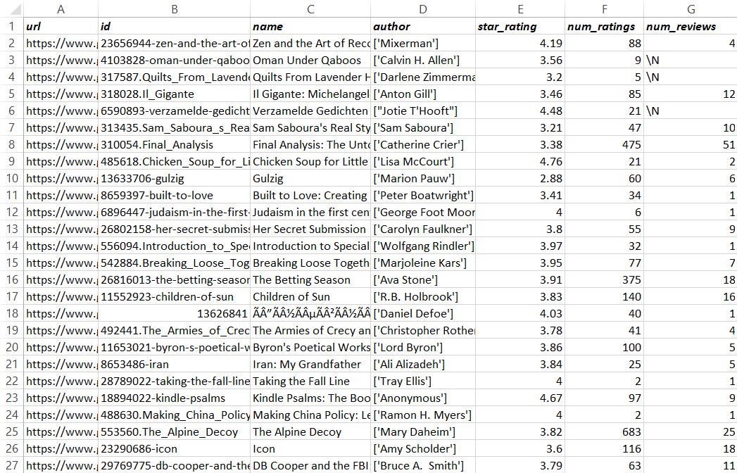

Slide 7
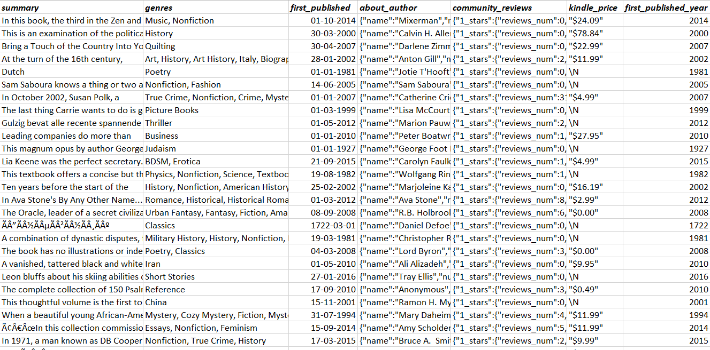

Slide 8



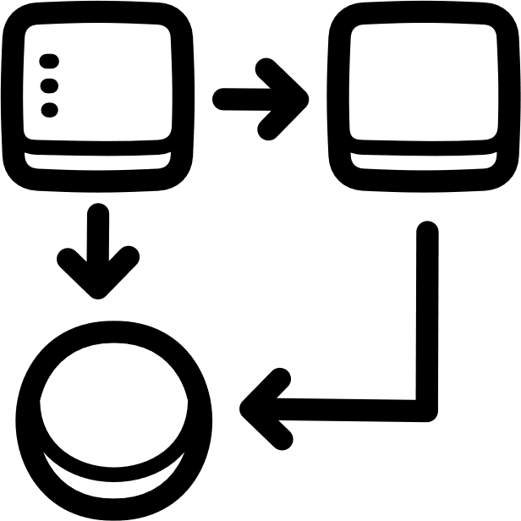

Plan for the analysis
Cleaning
Exploratory Data Analysis (EDA)
Modelling
Evaluation
Fix missing values
Remove duplicates
Correct data types
Visualize data
Find patterns
Select features
Choose a model
Train it
Tune it
Check accuracy
Compare models

Slide 9





Cleaning & EDA
CRISP DM (Cross Industry Standard Process for Data Mining)
Followed structured steps: data understanding, data preparation, modeling, evaluation
Analysis
Cleaning: Removed nulls & irrelevant fields, cleaned summaries.
Transformation: Normalized, lemmatized, imputed genres from summaries.
Modeling: TF-IDF + KNN and SVD are evaluated using Precision & Recall.

Slide 10
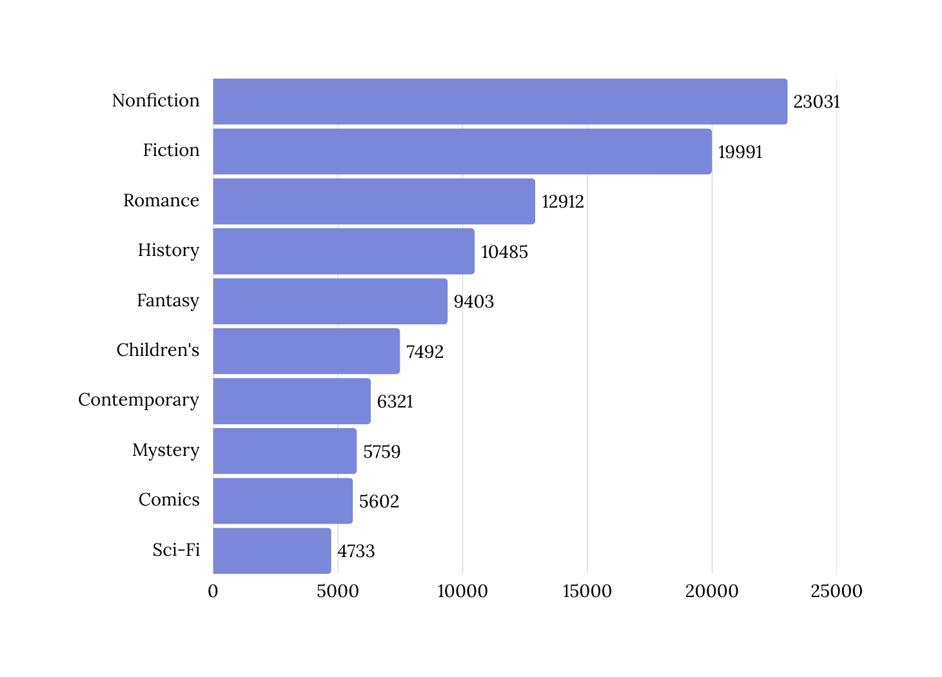
Visualization of Dataset
Top 10 Most Common Book Genres
The original dataset had ~390,000 rows, but processing it caused memory issues. To ensure stability and data quality, we reduced it to ~100,000 rows by dropping entries with missing or malformed data.

Slide 11
Models implemented
Feature / Aspect | TF-IDF + KNN (Content-Based) | SVD (Collaborative Filtering)
Based on | Book content (title, genre, authors) | Title and User interactions
Data Required | Text data from books | User-item rating matrix
Personalization Level | Suggests similar books to one, the user already liked | Suggests books based on similar user preferences
Similarity Focus | Finds books similar in content | Finds users/books with similar behavior or rating patterns
Performance in Our Project | Good, but limited by content features | Better performance, higher accuracy in recommendation

Slide 12
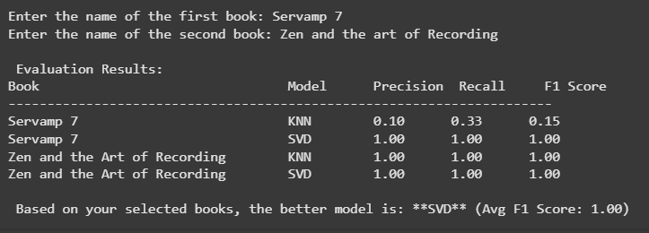
Metrics
Criteria | KNN | SVD
Evaluation on "Servamp 7" | Precision: 0.10 Recall: 0.33 F1 Score: 0.15 | Precision: 1.00 Recall: 1.00 F1 Score: 1.00
Consistency | Inconsistent – varies by book | Highly consistent across books
Strengths | Performs well when content is rich & clear | Handles sparse data and user behavior effectively
Overall Recommendation | Use cautiously, book-dependent | More reliable and accurate overall

Slide 13
Conclusion
In Conclusion- KNN and SVD were both tested for our book recommendation system. While KNN performed well in some cases, it was inconsistent and struggled with certain books due to limited content data. In contrast, SVD showed consistent and accurate results by analyzing user-book rating patterns, achieving perfect scores across test cases. Overall, SVD outperformed KNN and is the more reliable choice for personalized recommendations.

Slide 14


Thank you

Slide 15
